Slide 1
Heat Map in R
Michelle M

Slide 2
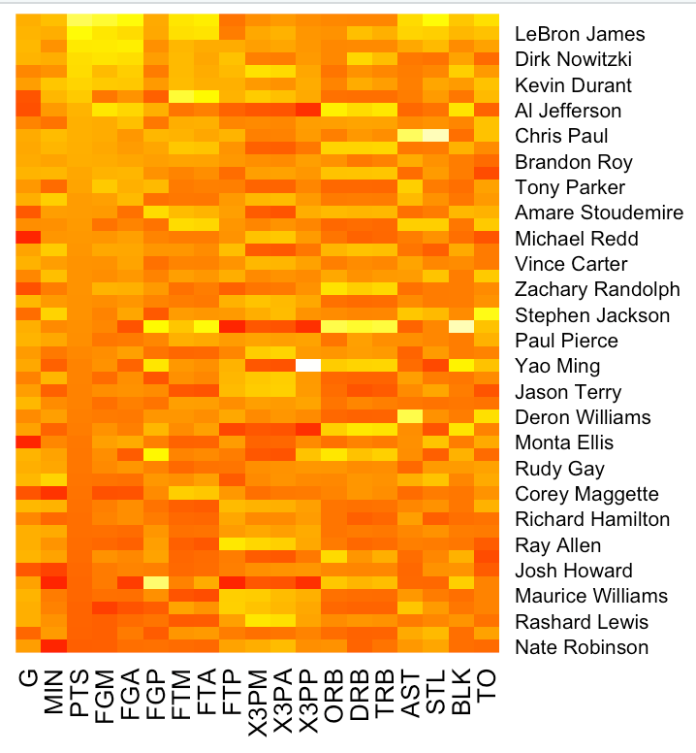
A heatmap is a visual way to see highs and lows of a data set. It uses colors in place of numbers and the intensity of the color is the indicator of how strong the value is.

Slide 3



Load, sort and prepare
Load the data into R, here I am using NBA player stats
The data can be sorted any way, but we will sort by points ascending
The row names were just numbers so we can change them to player names, then remove that extra number index row

Slide 4

Change the data into a matrix

Slide 5
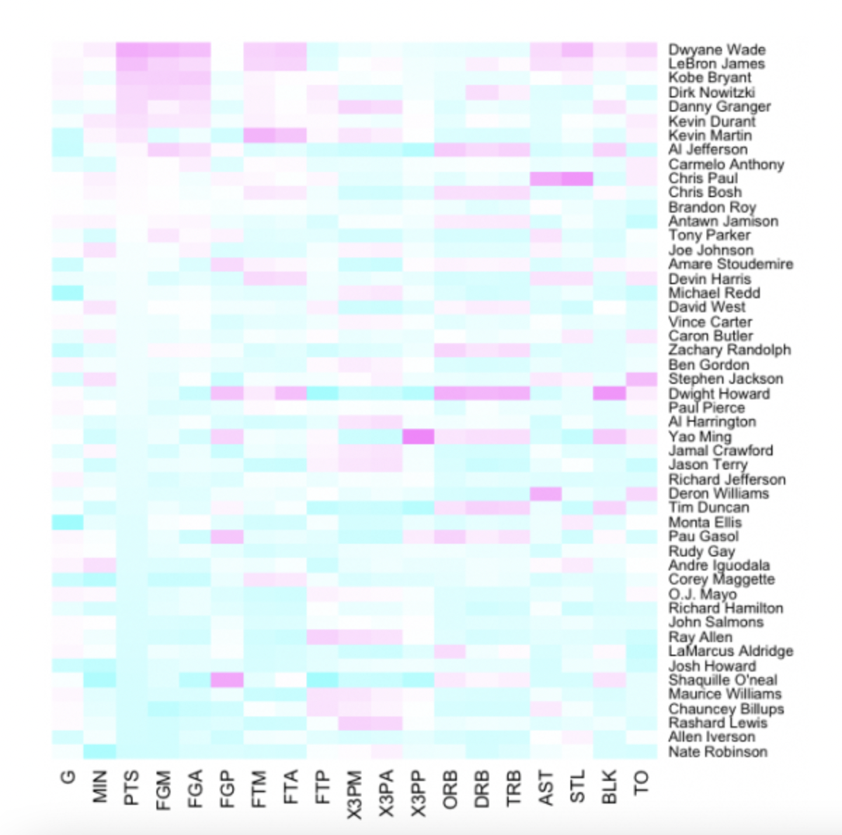
Creating the heat map

Slide 6


Make it pretty!
Change this section to customize the colors!!

